Slide 1
Welcome to Schuylkill Environmental Careers Online Training
Diana Maher
Sarah Crothers

Slide 2
Diana Maher
Sarah Crothers
Education Coordinator
dmaher@schuylkillriver.org
Education Director
scrothers@schuylkillriver.org
Notes:
Both

Slide 3
Introductions
Notes:
popcorn

Slide 4
Before We Start
Make sure to sign SmartWaiver link
No risk to this program
Photo Release
Notes:
Sarah (I sent them all the link twice through email, a handful still have not signed it)

Slide 5
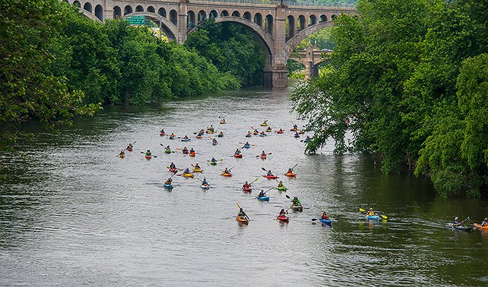
An NHA is designated by the government
Encourages historic preservation of a landscape
Connects residents and visitors to the Schuylkill River to promote civic engagement and economic growth
Provides educational resources, hosts events, maintains health or river and trail
Photo: GoPhillyGo
Notes:
Sarah

Slide 6
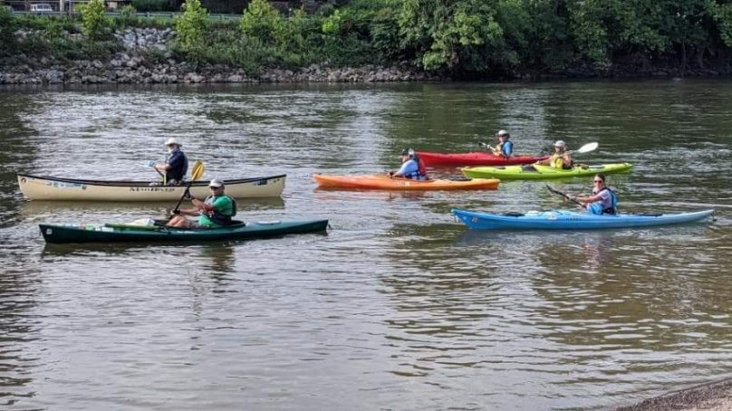
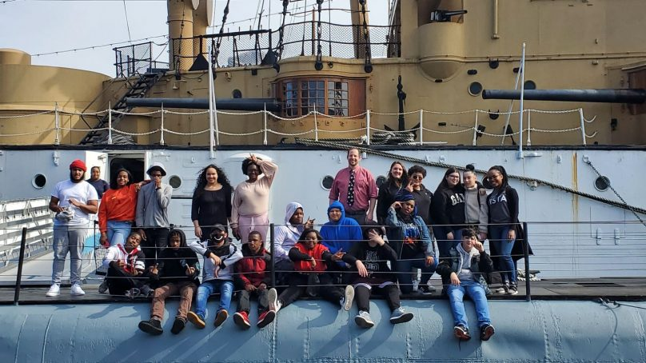
Some Programs and Projects
Maintenance and development of Schuylkill River Trail
75 completed miles along the river
137 mile water trail
Community events
Ride for the River
Sojourn
Education
Schuylkill Explorers
Junior Ranger
Operation Pollination
SECO
Notes:
Sarah

Slide 7
Schuylkill Environmental Career Opportunities (E.C.O.)
Mission:
Present high school students with environmentally-focused job opportunities in federal, state, nonprofit, local, and private sectors
Provide hands-on educational opportunities that link students with the natural environment
Inspire the next generation of watershed stewards.
Notes:
Diana

Slide 8
Schuylkill Environmental Careers Online Training
Mission:
Present students and young professionals with environmentally-focused job and educational opportunities
Provide participants with information and tips on how to enter any career field
Discuss and learn more about environmental importance and emerging issues
Provide a safe, socially-distant space for students young professionals to learn more about entering an environmental career field
Notes:
Diana

Slide 9
Goals of SECOT
Upon completion of this course, students and young professionals will acquire and learn desirable skills and tools needed to enter the environmental career field
Participants will understand new emerging issues that professionals are facing
Participants will gain transferable and essential professional skills to enter any career field
Notes:
Diana

Slide 10
Topics of Each Session
February 2: Introduction and Watersheds
February 9: Career and Educational Opportunities
February 16: Resume Building and Cover Letter Writing
February 23: Interviews
March 2: Professional Mentors
March 9: Professional Mentors 2
Notes:
Diana

Slide 11
Professional Mentors
Kelly Knutson
Director for the Coalition for the Delaware River Watershed
Garrett White
Biological Science Technician at John Heinz National Wildlife Refuge
Kate Hanley
Director for Climate Strategy for Aramark
Notes:
Sarah

Slide 12
Benefits of Participating
Learn how to search and apply for jobs
Network
Improve and build your resume
Learn more about environmental issues
Receive a certificate of completion and other free gifts
Notes:
Sarah

Slide 13
Requirements for Completion
Attend every hour long session each week
1
Complete weekly assignments
2
Participate in discussions
3
Complete post survey
4
Notes:
Diana

Slide 14
Resources
Schuylkillriver.org/seco
Syllabus
PowerPoints
Informational worksheets
Notes:
Diana

Slide 15
PFAS
“Forever Chemicals”

Slide 16
What is PFAS
Per- and polyfluoroalkyl substances (PFAS)
A family of synthetic chemicals
Found in many products, such as nonstick cookware, some food packaging, fire extinguishing foams
Water-repellant
Heat resistant
Image: Washington State Department of Ecology

Slide 17
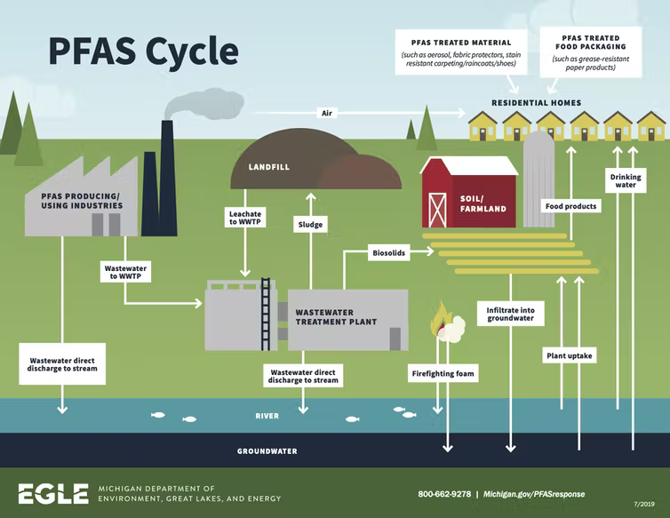
Why are they a problem?
Adverse health effects
Do not break down
“Forever Chemicals”
Bio accumulate
Found in 99% of people
Contaminates water
Found in bottled water, surface water, and ground water
Group of over 3,000 chemicals
Used in many industries

Slide 18
PFAS Regulations
Currently, there is no MCL for any PFAS chemicals according to The National Primary Drinking Water Regulations
The EPA has established a non-enforceable health advisory level of 70 parts per trillion (ppt)
No federal regulations regarding PFAS in water
The Delaware Riverkeeper Network has been fighting for regulation since 2017
It will be years before a Mandatory Contamination Level (MCL) will be implemented

Slide 19
1940s
Chemicals created and used in 3M products
1950s
Used by DuPont for Teflon
1960s
Studies indicate liver damage
1980s
Adverse environmental effects indicated
1999
Contamination appearing in blood banks around the country
2005
EPA declare “likely” carcinogen
2007
Estimated to be in 98% of American’s bloodstreams
2011
Detected in groundwater
2016
EPA Health Advisory

Slide 20
Discussion
Why do you think it has taken so long for standards to be proposed?
When do you think regulations should have been implemented?
Do you think this issue is discussed enough?
How do you think industry has affected government standards?

Slide 21
Next Week
February 9th, 6:00-7:00pm
Career and Educational Opportunities
Assignment:
Watershed Scavenger Hunt
Find it on our website schuylkillriver.org/seco

